Slide 1
Apache Kafka, Apache Nifi, Bold BI

Slide 2

Product Manager, Dashboard Analytics, Syncfusion Software.
https://twitter.com/dinuswt22
https://github.com/dinesarun/common

Slide 3

Why Kafka?

Slide 4
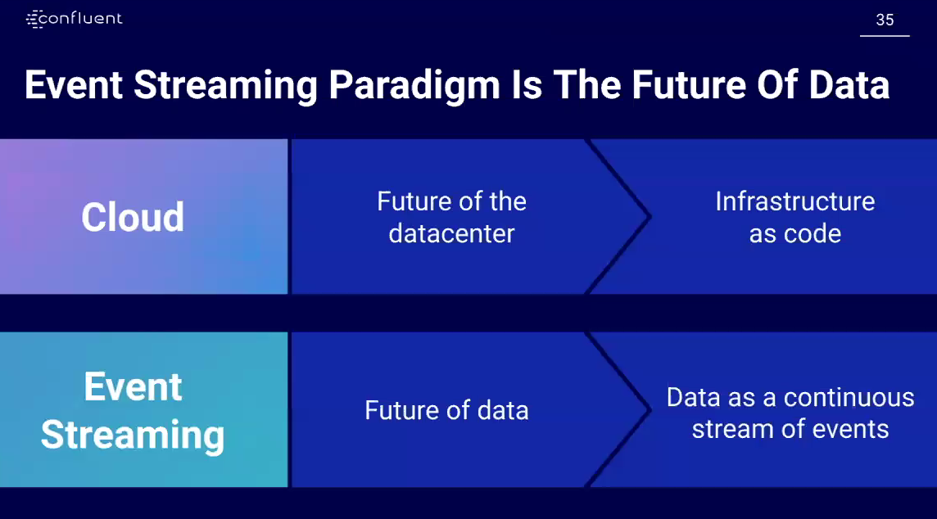

Slide 5
What is a Company?

Slide 6


Slide 7


Slide 8


Slide 9
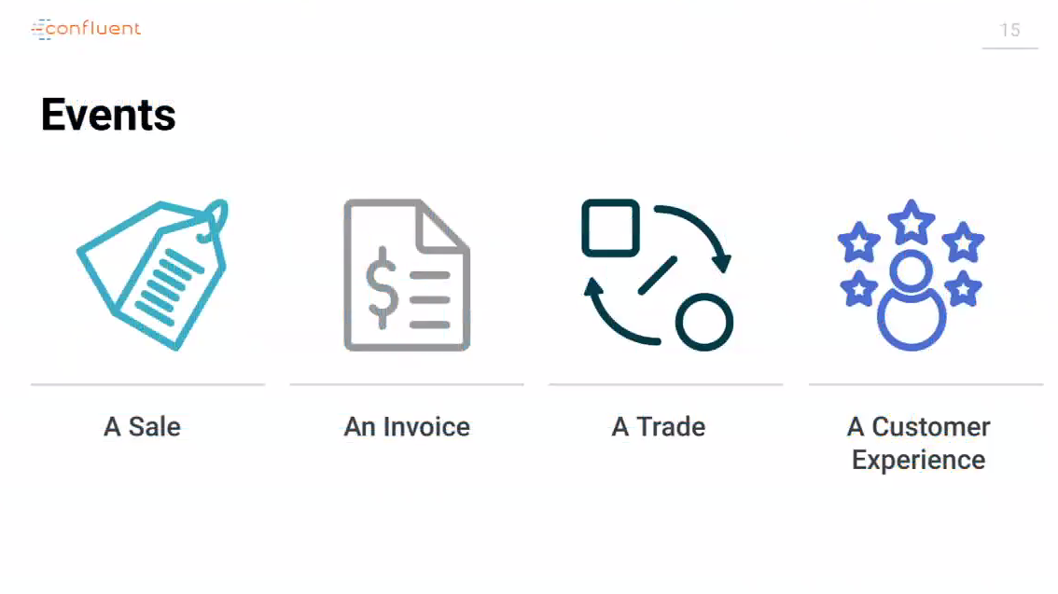

Slide 10
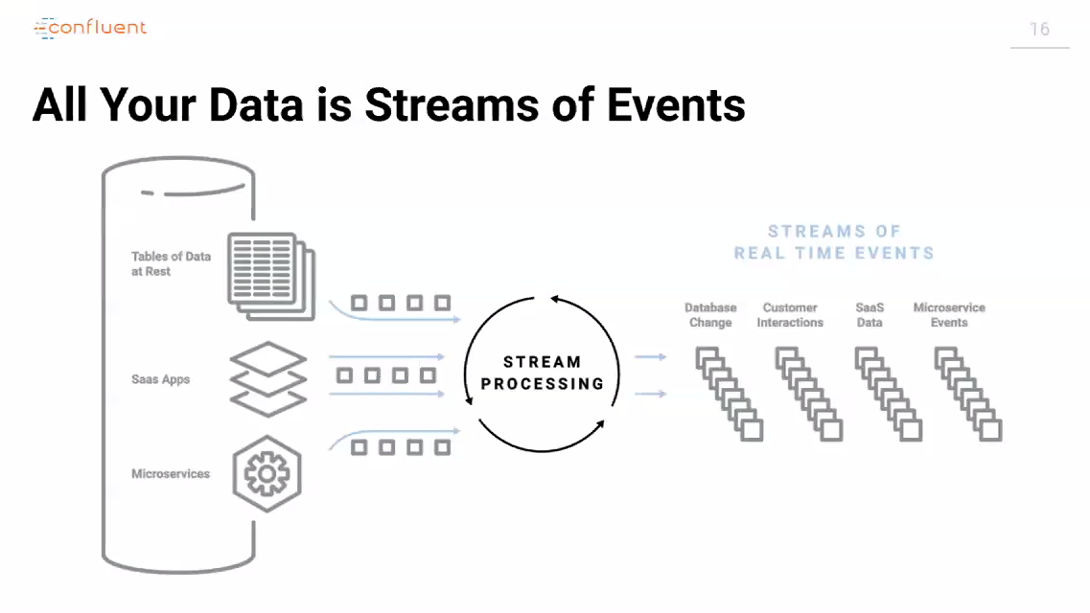

Slide 11


Slide 12
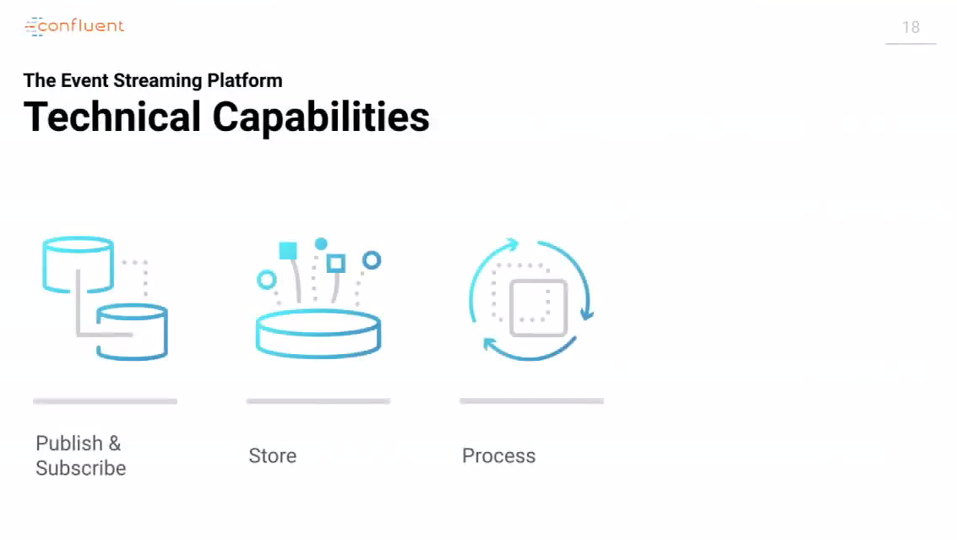

Slide 13
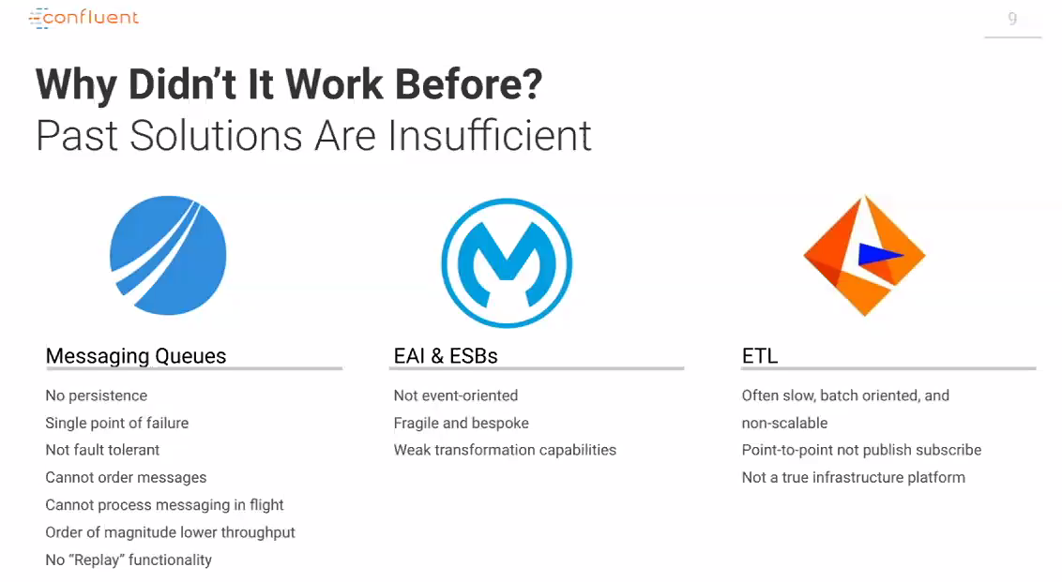

Slide 14
Why Kafka?

Slide 15


Slide 16
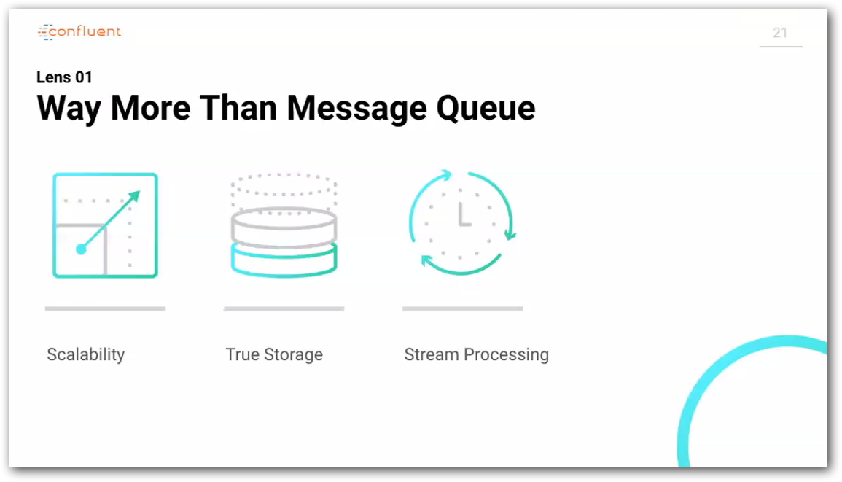

Slide 17
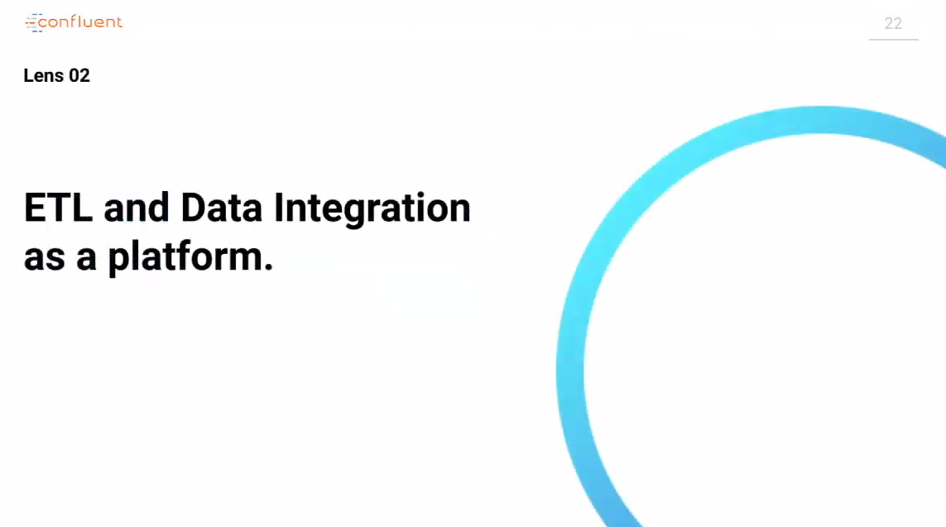

Slide 18
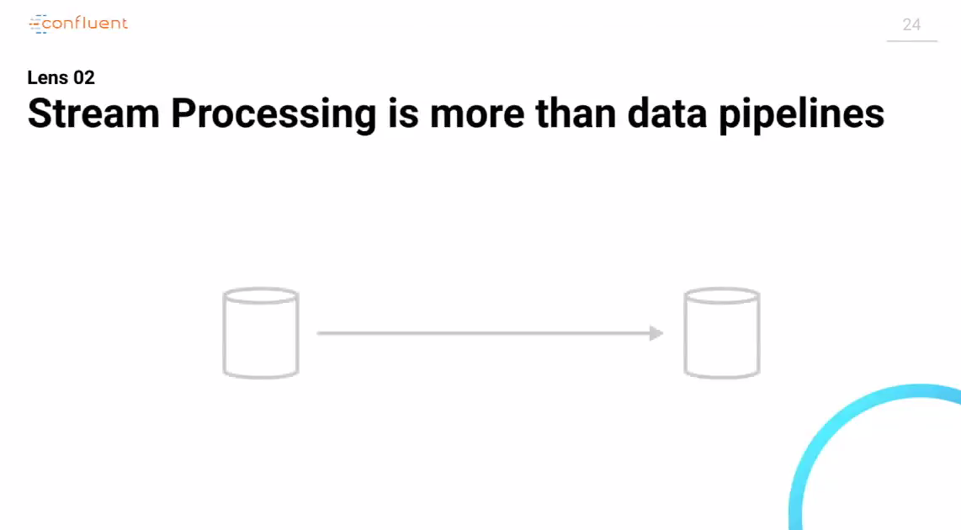

Slide 19
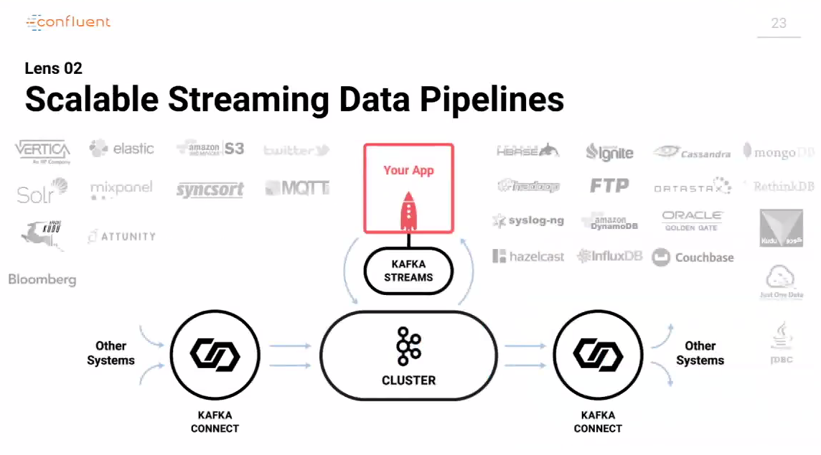

Slide 20
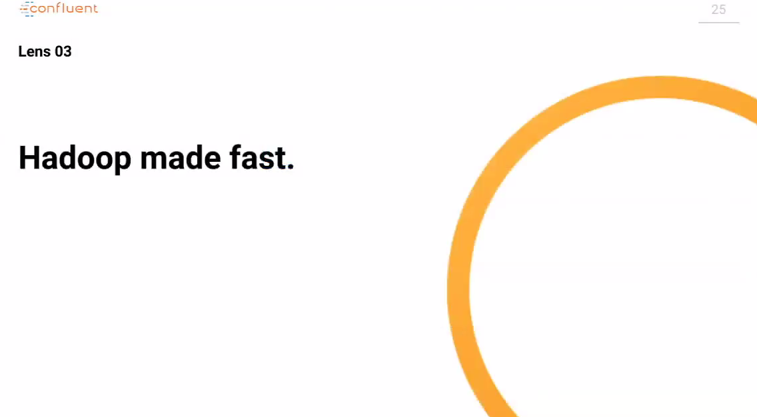

Slide 21
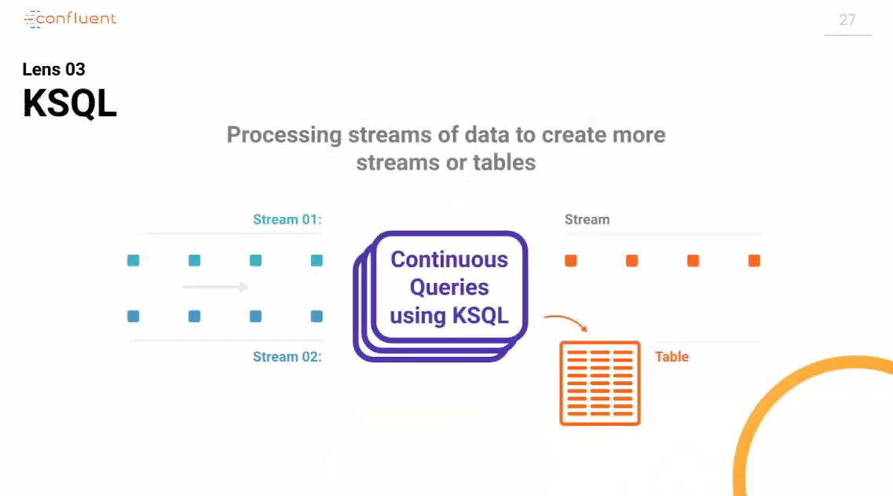

Slide 22
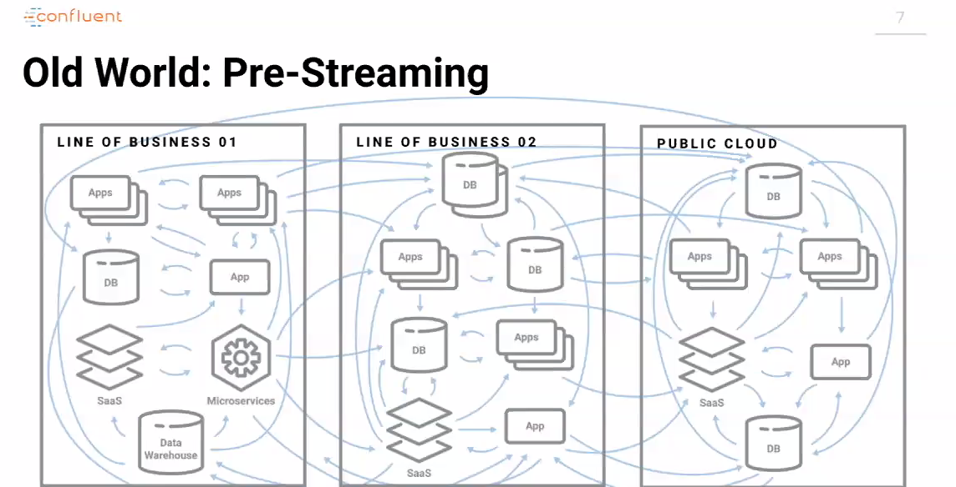

Slide 23
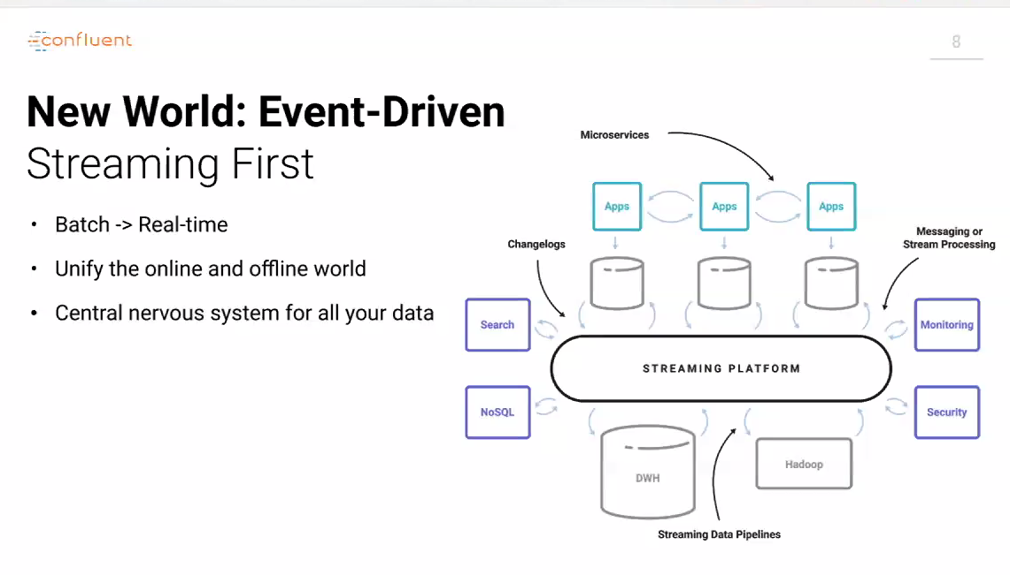

Slide 24
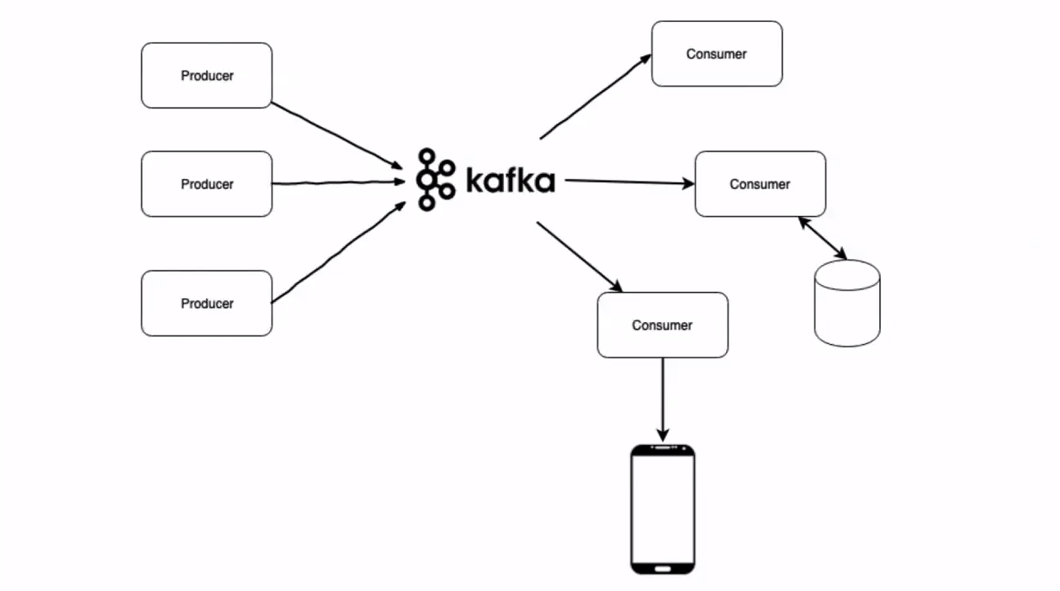
Apache Kafka
Notes:
Apache Kafka is a distributed, partitioned, replicated commit log service. It provides all of the functionality of a messaging system, with a distinctive design.

Slide 25
DEMO - 1

Slide 26
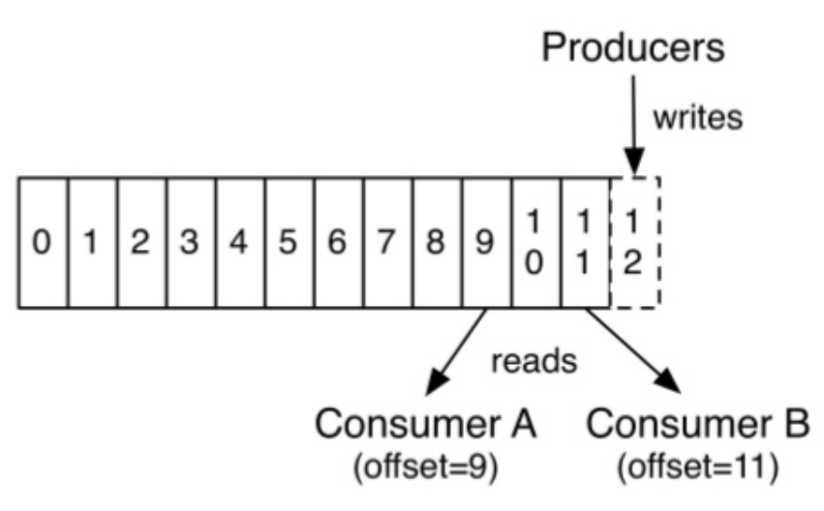
Efficient Structure for Retaining and Distributing Messages
Notes:
The producer simply appends messages to the topic, and the consumer decides, by offset, which messages to consume from the topic!

Slide 27
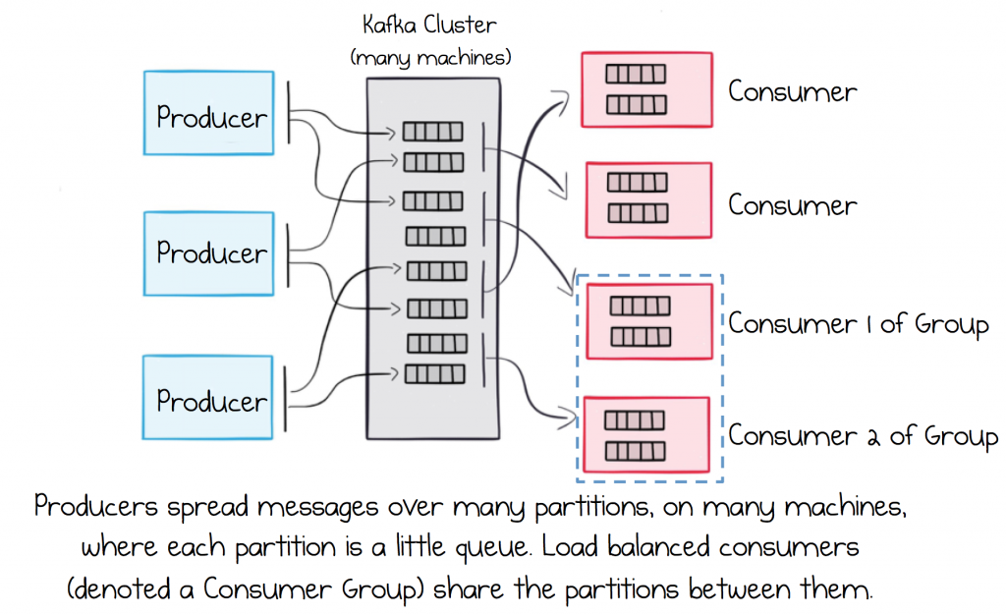
Rely on a Broker that Scales Out Linearly

Slide 28
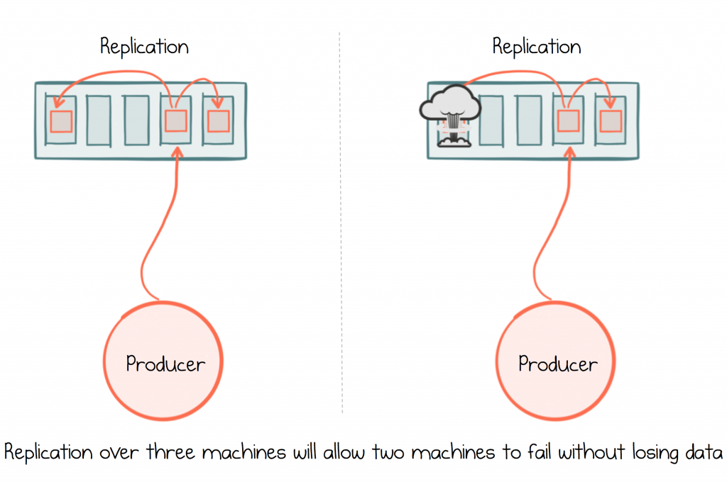
Ensure Messages are Durable

Slide 29
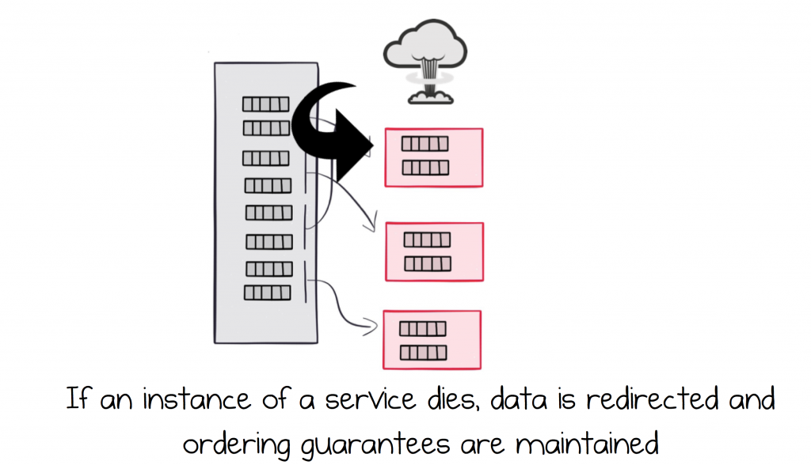
Load Balance Services and make them Highly Available

Slide 30
Use cases and Implementations

Slide 31
Hotstar

Slide 32
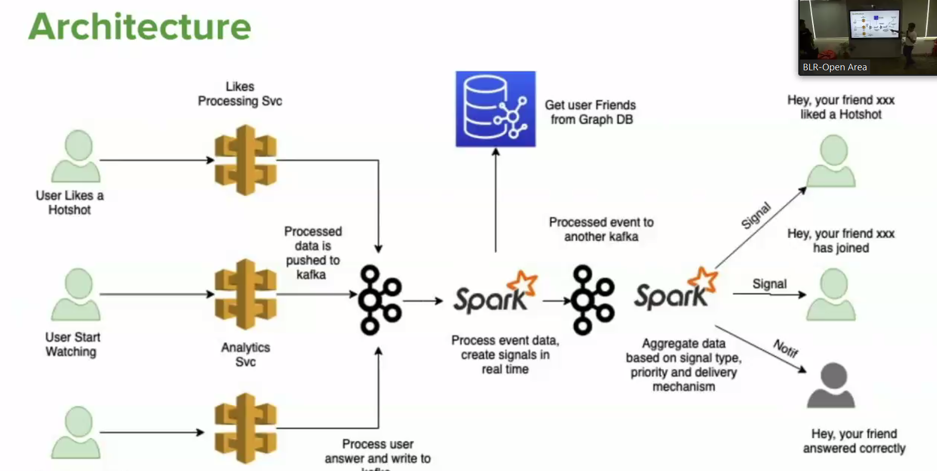
Hotstar

Slide 33
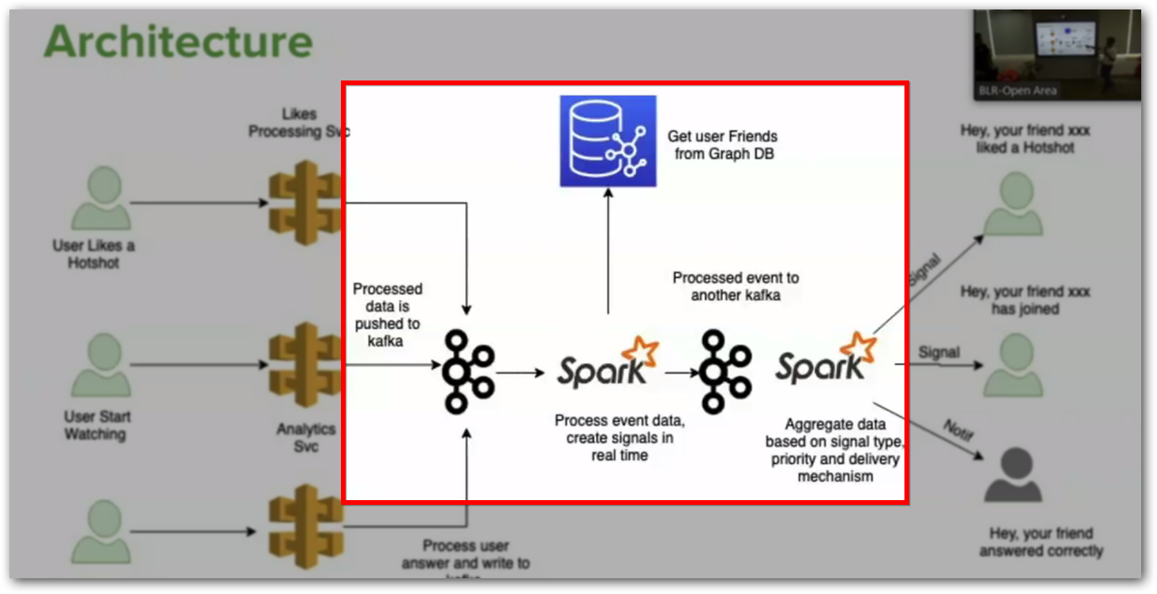
Hotstar

Slide 34
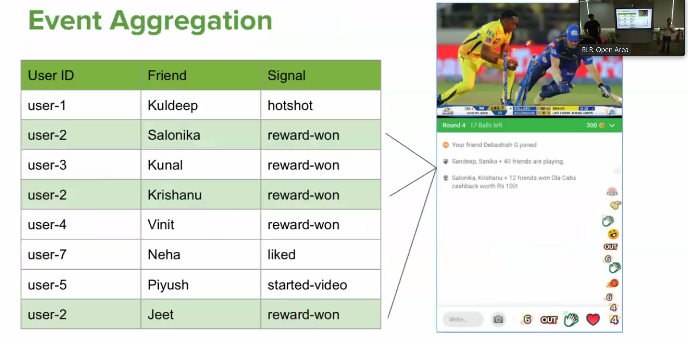

Slide 35
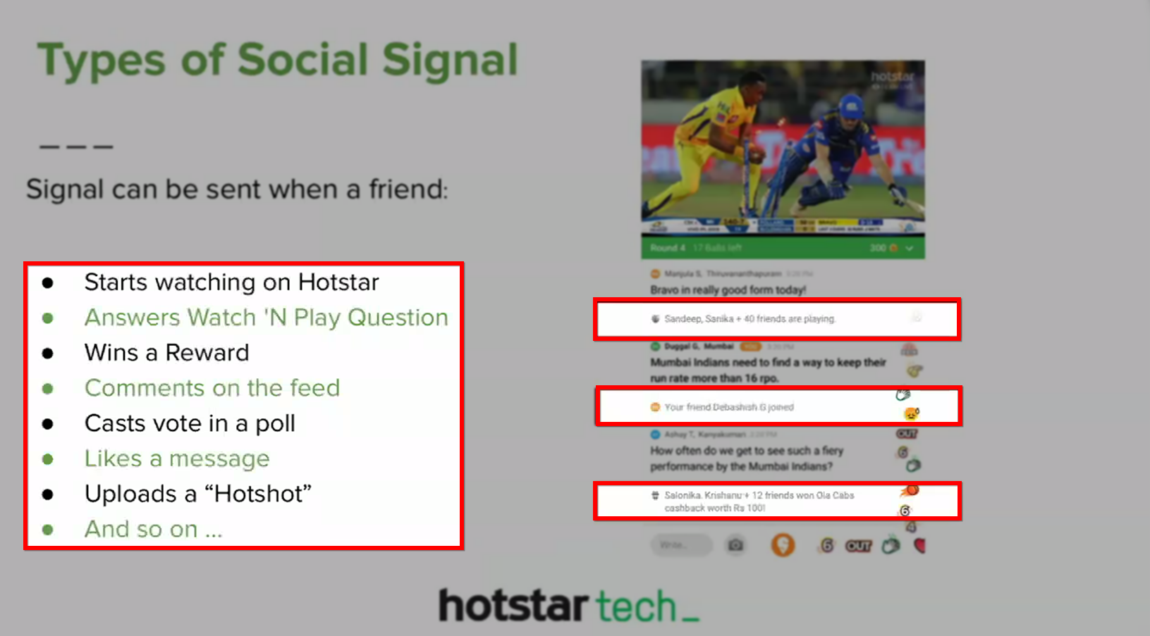

Slide 36
Uber

Slide 37
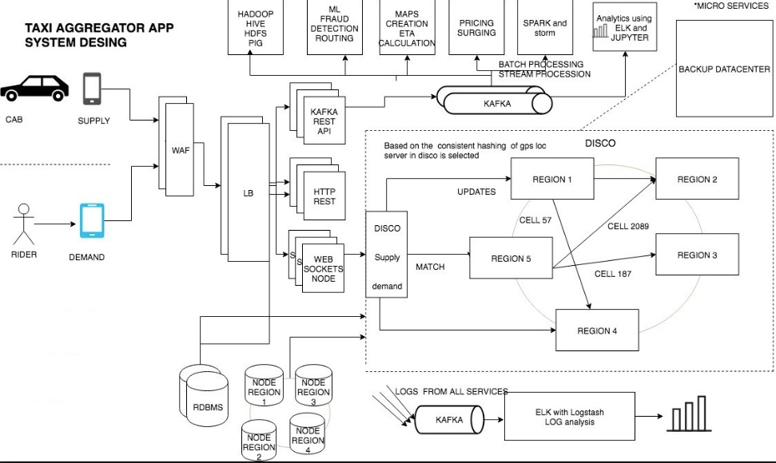

Slide 38
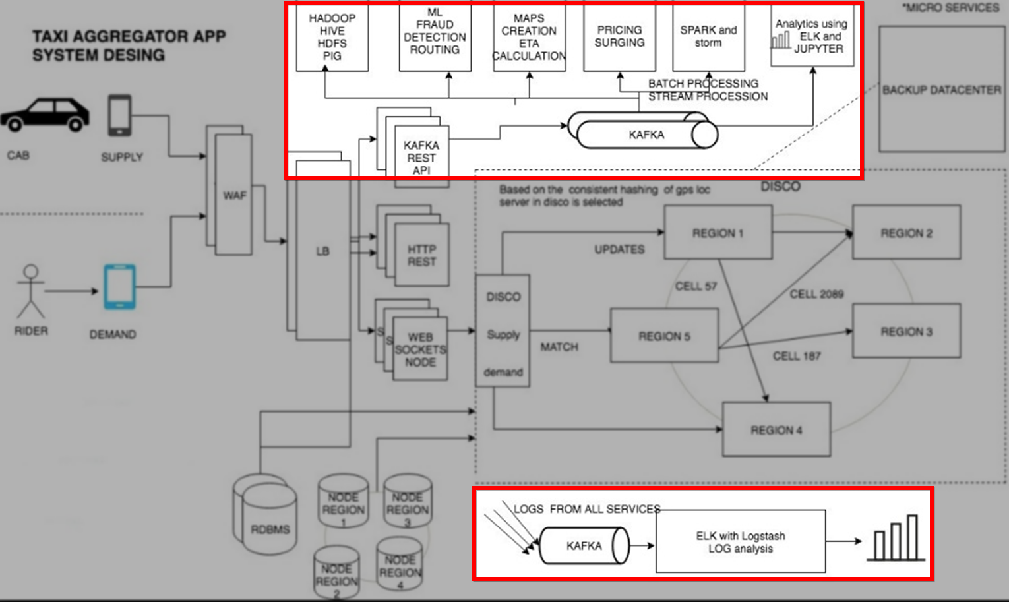
KAFKA REST API - responsible for receiving all the traffic sent by the supply (cars) and demand (users)

Slide 39
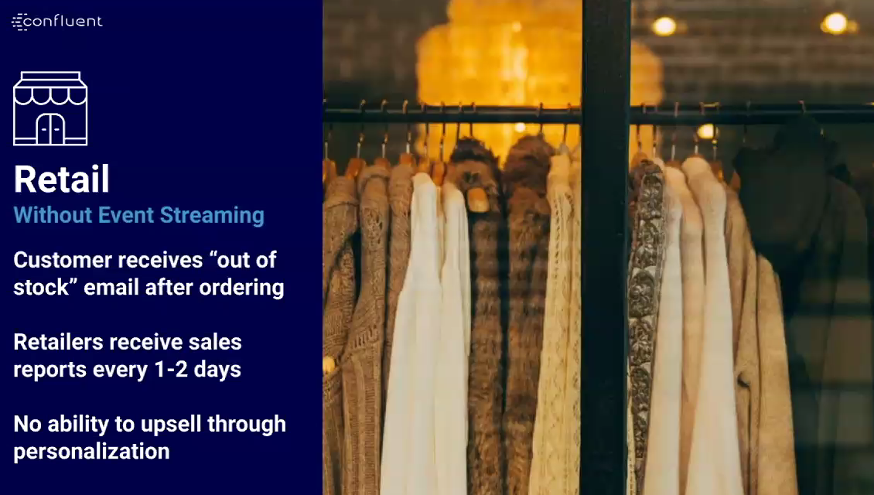

Slide 40
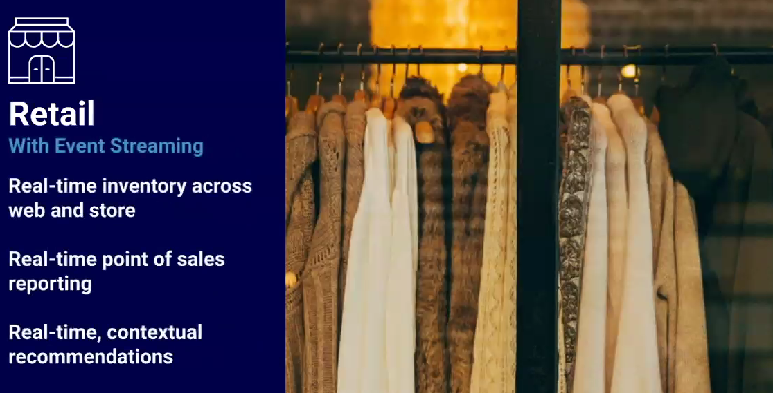

Slide 41
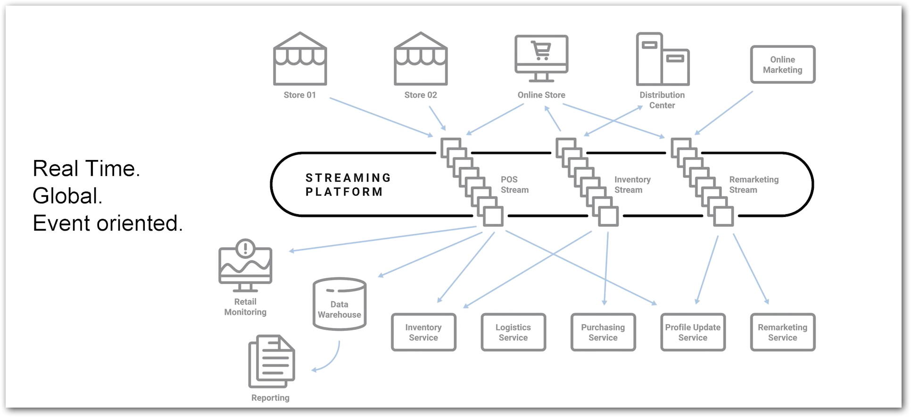

Slide 42
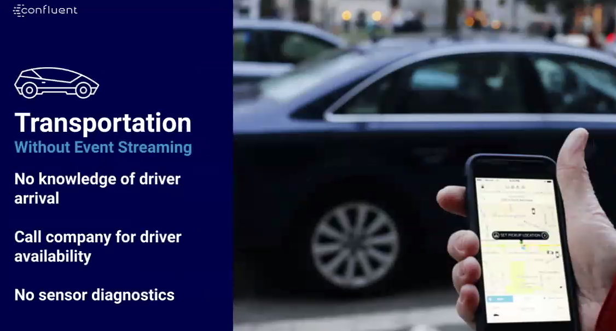

Slide 43


Slide 44


Slide 45


Slide 46
DEMO - 2

Slide 47
Apache Nifi
Data flow management tool for ETL (Extract Transform Load)
Can deal with SQL, NoSQL, Rest, Hadoop data sources.
Process streaming (live tweets from twitter) and batch (file processing) data.
Cluster supports to run workflow in multiple nodes in order to overcome failure of workflow.
User policies helps to provide access privilege for the deployed workflow.

Slide 48
Bold BI
Business intelligence tool.
80+ connectors. (SQL, NoSQL, File, Web)
Easy drag and drop designer.
Dashboards renderable in Mobile, TV, Large screen displays.
Available as SaaS, On-premise and Embedded forms.
Drilled down maps, Forecast feature.

